Slide 1



















Amplify, Automate, Reinvent..
AI & Automation Services
Customer Reviews – Sentiment Analysis

Slide 2
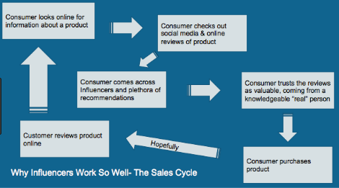
What is the Problem?
Problem Description
Today, digital reviews play a pivotal role in enhancing global communications among consumers and influencing consumer buying patterns. E-commerce giants like Amazon, Flipkart, etc. provide a platform to consumers to share their experience and provide real insights about the performance of the product to future buyers. In order to extract valuable insights from a large set of reviews, classification of reviews into positive and negative sentiment is required.
79% of businesses believe that online reviews play an important role in influencing consumer decision making.
62% of online consumers claim they are more likely to do business with a company after reading a positive review.

Slide 3
How the problem was solved?
Solution Approach
Data preprocessing, NLP Techniques on review data for tokenizing words and phrases
Normalization of the data
Reviews with rating 4 and 5 are labelled as positive reviews. reviews with rating 1 ,2 and 3 are labelled as negative reviews.
Classification Algorithms Built to classify either as positive or negative review
Two Clustering models are built ,to group positive and negative word scoring words as clusters.
Words which are closest to the respective cluster centers are said to be the important words which decides the product review is either good or a bad review.
Data includes:
- 568,454 food reviews
- 256,059 users
- 74,258 products
- 260 users with > 50 reviews
Data Ingest
Data Preprocessing
Text Analytics
Normalization
Building the Classifier Model
Clustering Model
Extractor of positive words and negative words from clusters
Technology Usage
Machine learning
Text Analytics
Python
Model Evaluation

Slide 4
ML
Good
String
BAd
Customer review | Predicted Output
asdfasdfasdf | Good
asdfasdfasd | Bad

Slide 5
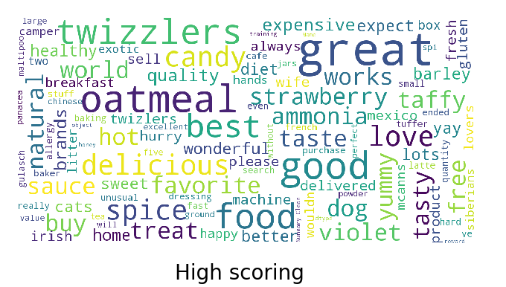
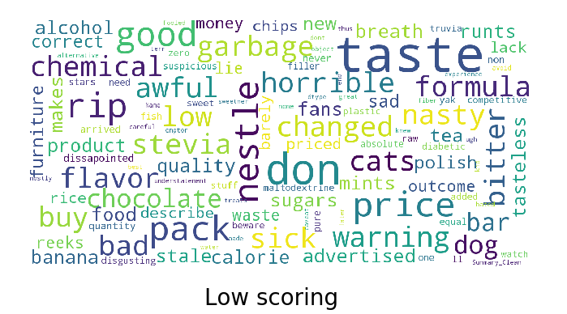
Word clouds for positive weighted words and negative weighted words

Slide 6

Thank You

